Slide 1
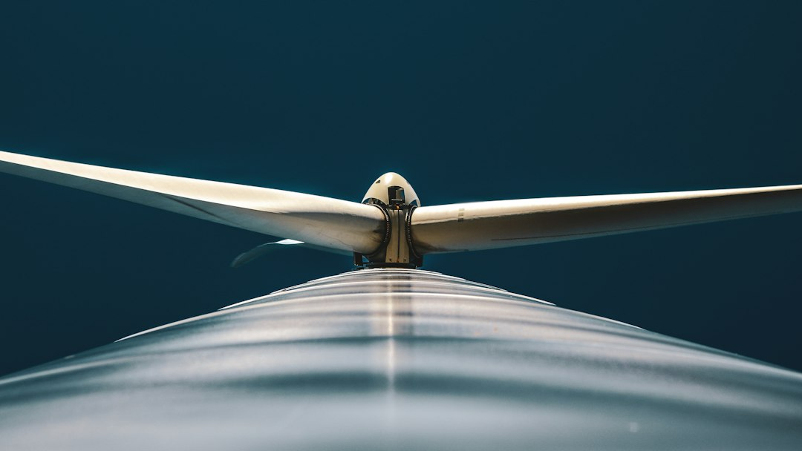
HAWTs vs. VAWTs
Scientific Analysis

Slide 2
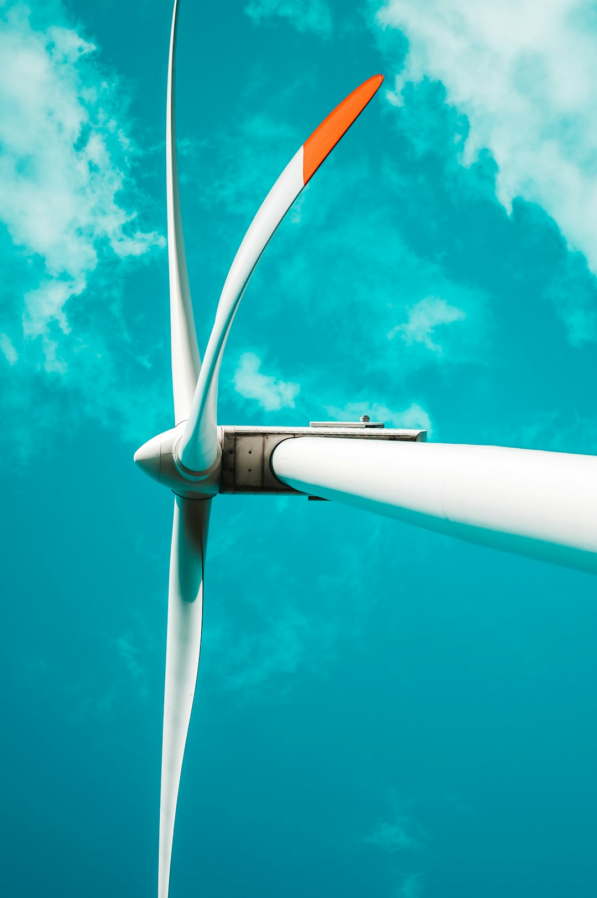
Abstract
Wind turbines play a crucial role in harnessing renewable wind energy for electricity generation.
A comparative analysis of two prevalent wind turbine designs : Horizontal Axis Wind Turbines (HAWTs) and Vertical Axis Wind Turbines (VAWTs).
Delves into the key differences between these two types in terms of their axis of rotation, wind direction requirements, operational efficiency, starting wind speed, and overall complexity. Additionally, we will explore the common materials utilized in both HAWTs and VAWTs, followed by a detailed examination of their respective methods of operation. Finally, we will discusses the current application landscape of HAWTs and VAWTs, highlighting their suitability for different scenarios.

Slide 3

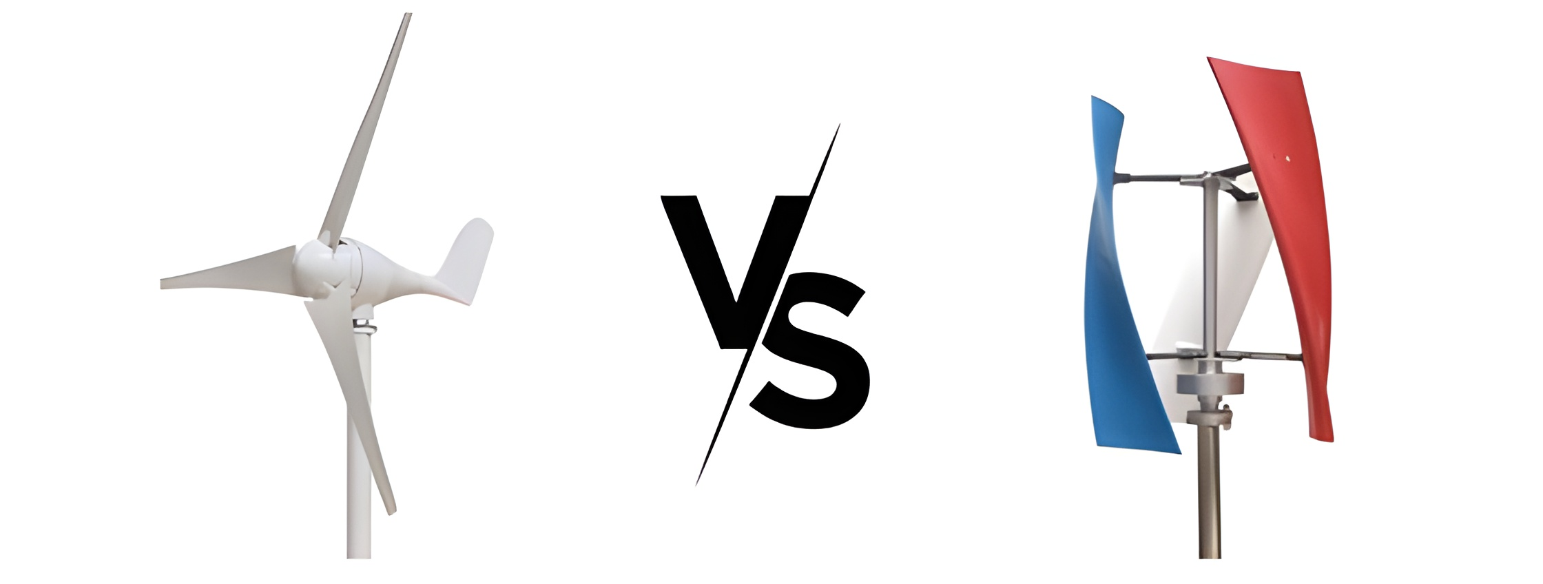
Key Differences
Axis of Rotation
HAWTs: Characterized by a horizontal axis of rotation, akin to a traditional windmill. The blades rotate parallel to the ground, capturing wind primarily through a lift force mechanism.
VAWTs: Possess a vertical axis of rotation, with blades spinning around a central shaft perpendicular to the ground. These turbines capture wind through a drag force mechanism, regardless of wind direction.

Slide 4
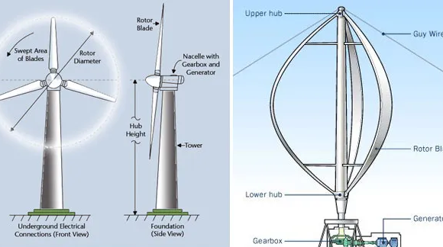
Wind Direction
HAWTs: Require direct wind direction for optimal operation, necessitating a yaw mechanism to continuously orient the nacelle (housing the generator) towards the prevailing wind.
VAWTs: Offer a distinct advantage by capturing wind from any direction, eliminating the need for a yaw mechanism. This simplifies their design and reduces maintenance requirements.

Slide 5
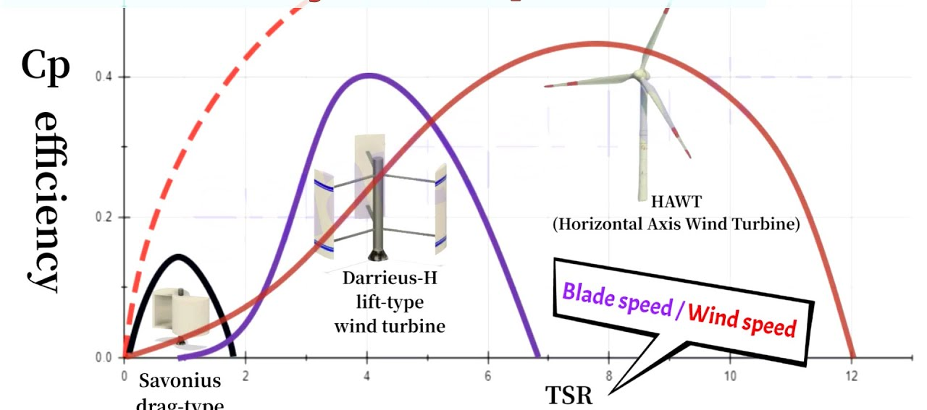
Efficiency
HAWTs : Generally, achieve higher efficiency (up to 50%) compared to VAWTs (35-40%). This is attributed to the consistent wind speed experienced by HAWT blades throughout their rotation cycle.
VAWTs : Exhibit lower efficiency due to the varying wind speed encountered by their blades during each rotation. However, advancements in VAWT design are continuously improving their efficiency.

Slide 6
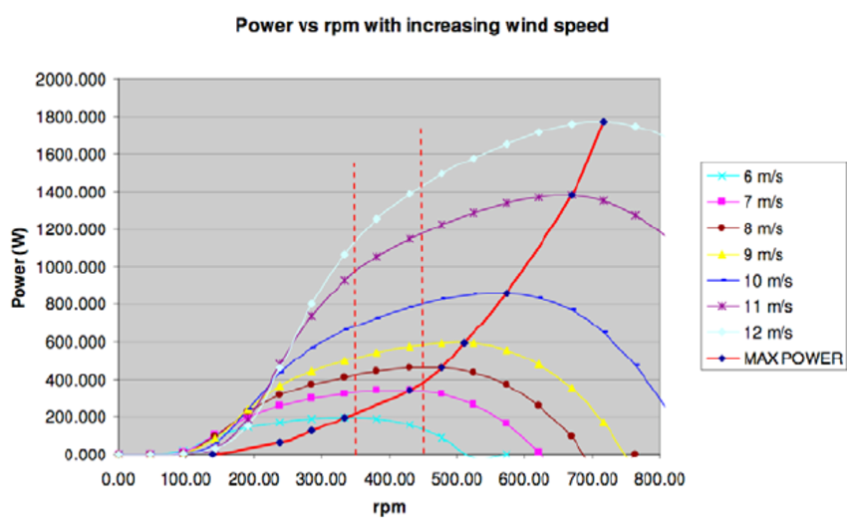
Starting Wind Speed
HAWTs : Require a higher starting wind speed to initiate rotation and electricity generation due to their reliance on lift force.
VAWTs : Can operate at lower wind speeds due to their utilization of drag force, making them suitable for areas with less consistent wind patterns.

Slide 7
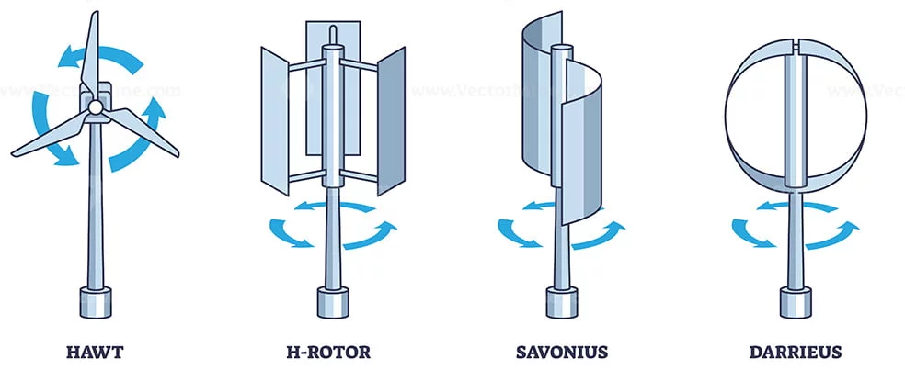
Complexity
HAWTs : Have a more complex design due to the yaw mechanism and placement of the gearbox at the top of the tower, which necessitates a heavier and more robust tower structure.
VAWTs : Possess a simpler design with the gearbox situated at the base, leading to a potentially lighter tower structure and potentially easier maintenance.

Slide 8
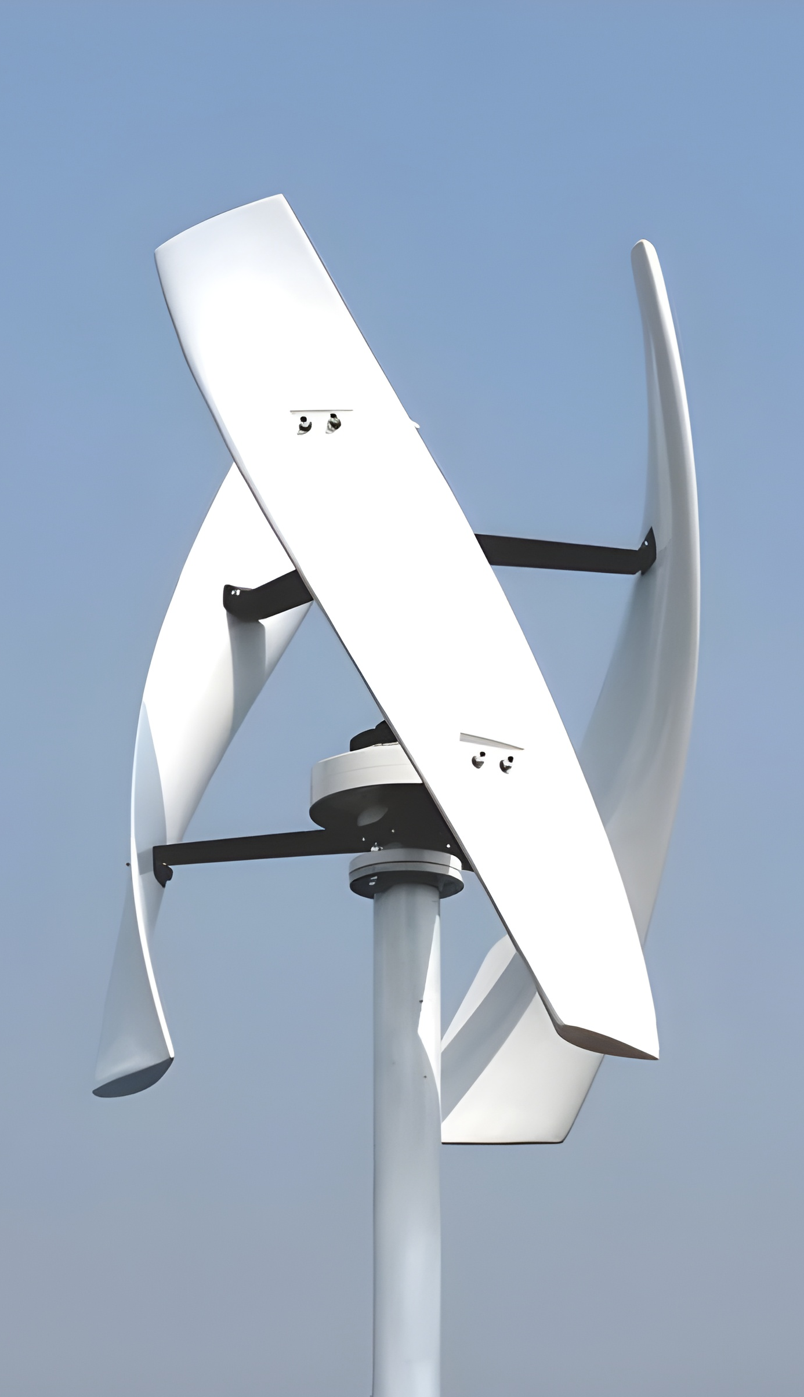
Materials
Both HAWTs and VAWTs primarily utilize the following materials:
Towers:
- Constructed from steel or concrete for superior strength and stability to withstand wind loads.
Blades:
- Traditionally manufactured from fiberglass or carbon fiber due to their lightweight and durable properties. Recent developments are exploring the utilization of wood and composites for improved sustainability.
Shafts and Gears:
- Employ steel due to its exceptional strength to support the turbine and efficiently transmit rotational forces.
Generators:
- Utilize copper windings and rare-earth magnets to convert the mechanical energy from the shaft into electricity.

Slide 9
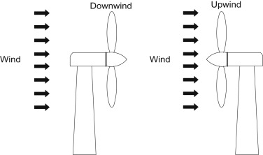
Method of Work HAWTs
Wind exerts lift force on the blades, causing them to rotate around the horizontal axis.
The rotational motion is transmitted through a gearbox to increase the rotational speed for efficient electricity generation.
The high-speed shaft drives the generator, housed within the nacelle, to produce electricity.
The yaw mechanism continuously adjusts the nacelle orientation to maintain alignment with the prevailing wind direction, maximizing energy capture.

Slide 10
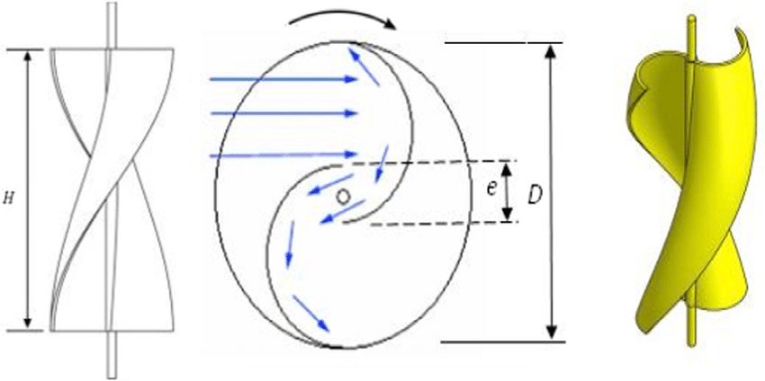
Method of Work VAWTs
Wind creates a drag force on the blades, regardless of their orientation relative to the wind direction, inducing continuous rotation around the vertical axis.
The varying wind speed across the blades during each rotation cycle impacts their efficiency compared to HAWTs.
In some VAWT designs,

Slide 11

Usage of Each Method
HAWTs
- Dominate the wind energy industry due to their higher efficiency Ideal for large-scale wind farms in open areas with consistent wind direction.
VAWTs:
- Gaining traction in recent years due to their, Ability to operate in urban areas with turbulent wind. Lower noise emissions compared to HAWTs, Potential for use in distributed generation applications like rooftops.

Slide 12
What is Q -blade?
QBlade is an advanced multi-physics software designed to facilitate the comprehensive aero-servo-hydro-elastic development, prototyping, simulation, and certification of wind turbines.
This powerful tool enables highly detailed simulations of wind turbine designs, featuring physics.
models that are more than 30 times faster than real-time. All this functionality is accessible through an intuitive and user-friendly graphical interface.
QBlade is available as standalone software for both Windows and Linux operating systems, with two distinct releases tailored for non-commercial and commercial applications.

Slide 13
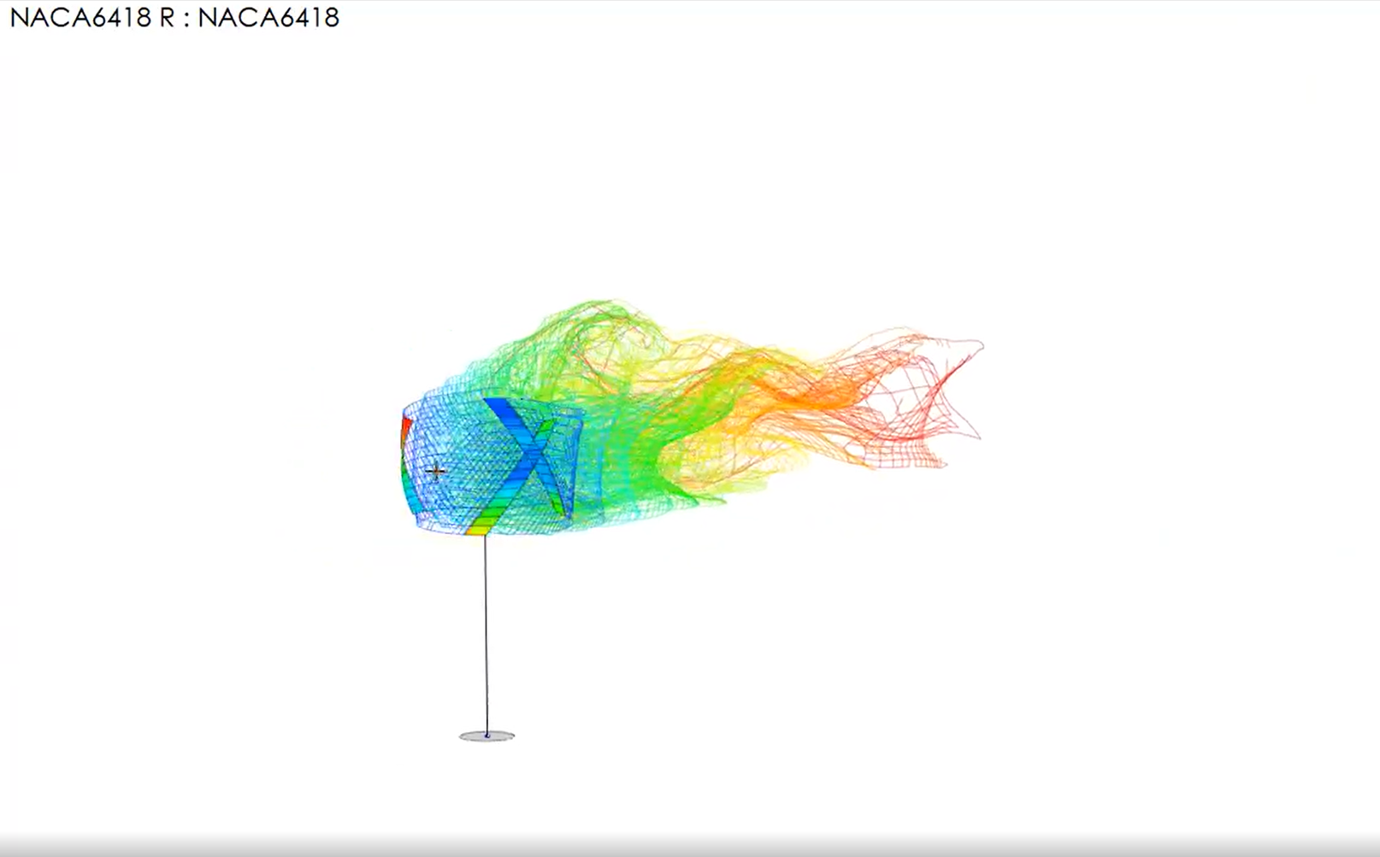
What is Q-Blade used for?
You can utilize QBlade for various purposes, including:
Wind Turbine Design (HAWT, VAWT and Multi-Rotor)
Floater Design and Numerical Testing
Controller Testing and Optimization
IEC Design Load Certification
Wind Farm Simulations and Wake Interaction Studies
Digital Twins in Python or Matlab Environments

Slide 14
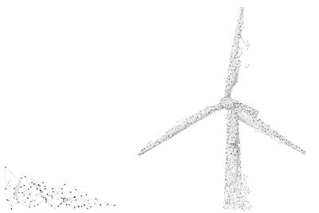
QBlade can provide several important results for wind turbines, including:
Power Coefficient:
- QBlade calculates the power coefficient, which is the ratio of the power output of the turbine to the power available in the wind. It indicates the efficiency of the turbine in capturing and converting wind energy. Higher power coefficients indicate more efficient turbines.
Thrust Coefficient:
- The thrust coefficient, calculated by QBlade, represents the ratio of the thrust force generated by the turbine to the dynamic pressure of the wind. It provides insight into the aerodynamic forces acting on the turbine.

Slide 15
Torque and Power Output:
QBlade can calculate the torque produced by the rotor and subsequently estimate the power output of the wind turbine. These results are crucial for assessing the energy production potential of a turbine design.
Blade Performance:
QBlade can provide detailed information about the aerodynamic performance of the turbine blades, including lift and drag coefficients, angle of attack, and pressure distribution along the blade span. These results are valuable for optimizing blade design and improving overall turbine efficiency.

Slide 16
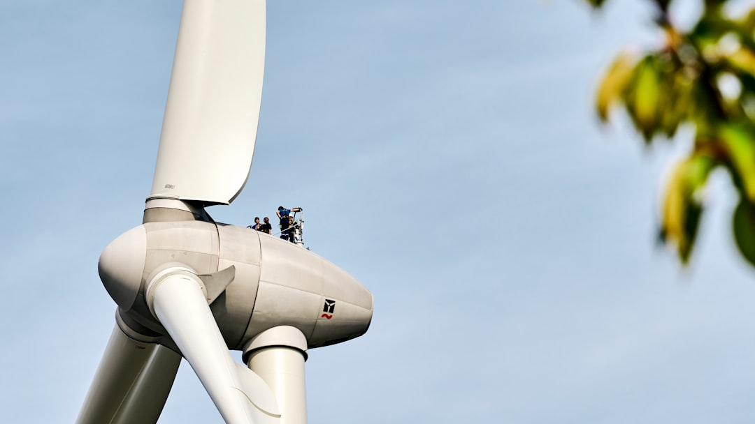
Thanks

